Slide 1
Customer-experience enhancement system
Team Dinosaur: Satyajeet Das, Soumya Dash & Qiao Xu

Slide 2
Introduction
The story behind the chrome dino game:
“It is a play on going back to the “prehistoric age” when you had no Wi-Fi”.---Chrome UX engineer: Edward Jung
Have fun when getting kicked offline
Deliberately kept simple, but not boring
Results: popular in countries with spotty data connection(too popular that some enterprise admins had to disable it for school kids/employees)

Slide 3
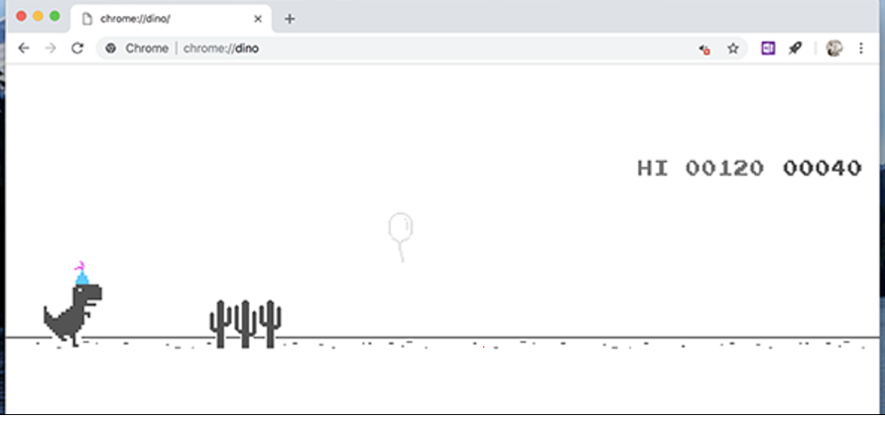
Introduction
Looks familiar? It is the chrome Dino game!!

Slide 4
Inspiration of our project
Project: (will go into details later)
Aimed user: Customer who need help with taking care of their children. (bank, supermarket,etc)
Problem: Inconvenient with children around, but no safe place to just leave the children.
Hire people to help take care of them—too much investment
leave phone to the children– not 100% safe; and not feasible for every customer; children still get bored when there is no internet.

Slide 5
Inspiration of our project
Inspiration from the dino game:
A way to have fun even when offline
Good attraction to children
Game is simple: anyone can play it, no need of the skills, no need of time to learn how to play
Could be perfectly embedded in the customer-experience enhancement system we design!

Slide 6
Project objectives
Game - Dino game is just one type of a game that can be implemented using Pico. Also, We are using PIO in RP2040 to interface with VGA display.
Person Detection - It would be utilized as a surveillance system for the children who will be playing the game. Also, Due to its automatic face tracking function, it would also be entertaining for kids.
Human Interaction:To create a human interaction interface that would ask the user its name, greet them, and play music based on their preferences.

Slide 7
System architecture
Dino
3 levels–different speed–different difficulty levels
Sound effect
Customer-experience enhancement system
LCD
& Speaker
Detect and
track people
Pan-Tilt camera
Greeting
Playing music

Slide 8
Components
SL No. | Component name | Quantity
1 | Raspberry Pi Pico | 2
2 | Raspberry Pi 4 | 1
3 | 1.8inch TFT LCD Display ST7735 | 1
4 | Mono class D audio amp with 8Ω 1W speaker | 2
5 | Push Button and its holder[3D Printed] | 1
6 | 330Ω Registers | 3
7 | VGA Display with VGA connector | 1
8 | Arducam Pan Tilt and Picamera with SPI Interface | 1
9 | Switches | 3

Slide 9
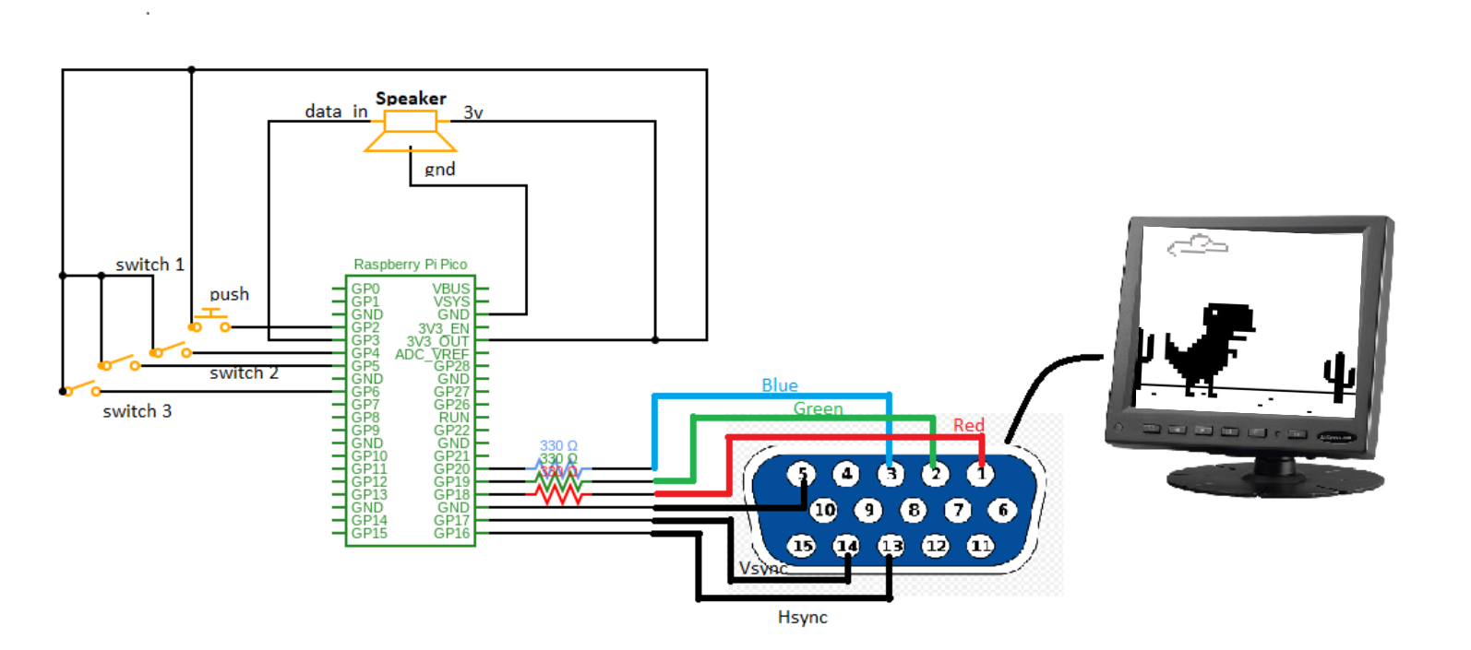
Circuit Diagram- Dino Game

Slide 10
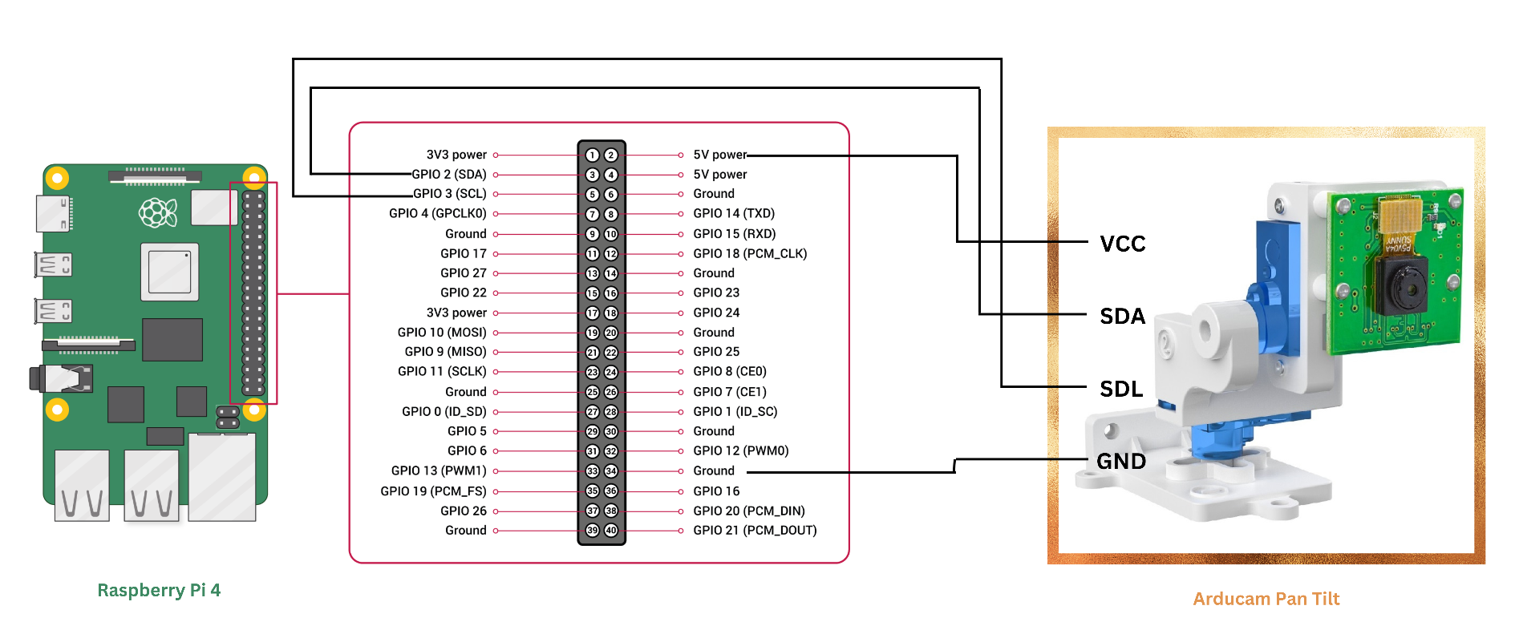
Circuit Diagram - Face Tracking

Slide 11
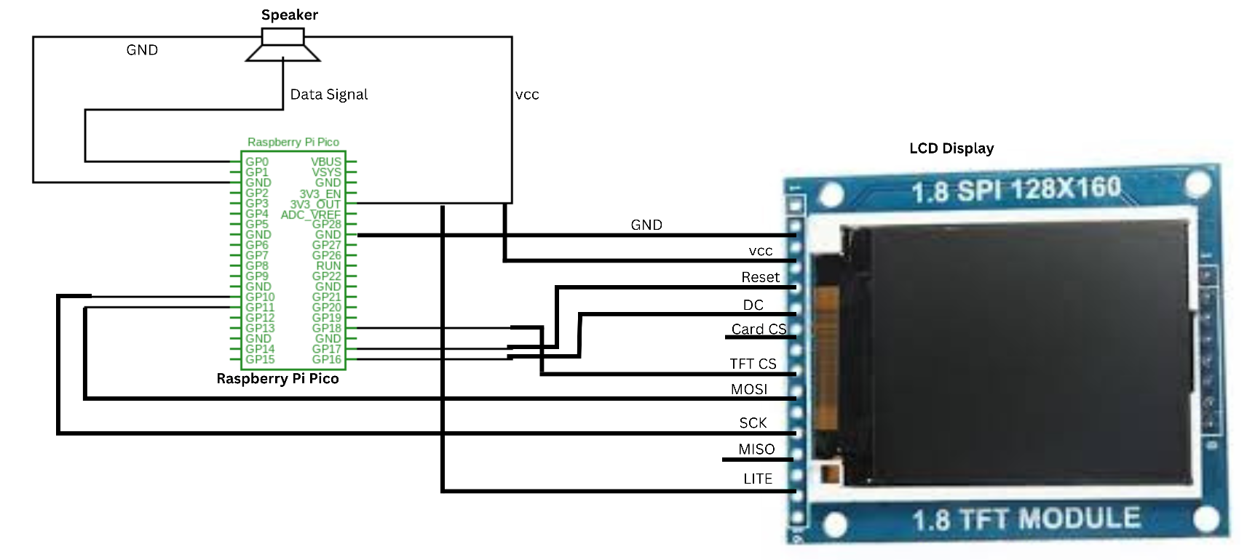
Circuit Diagram - Human Interaction

Slide 12
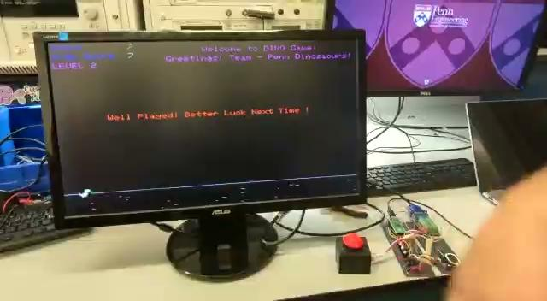
Result - Dino Game
Dino Game:

Slide 13

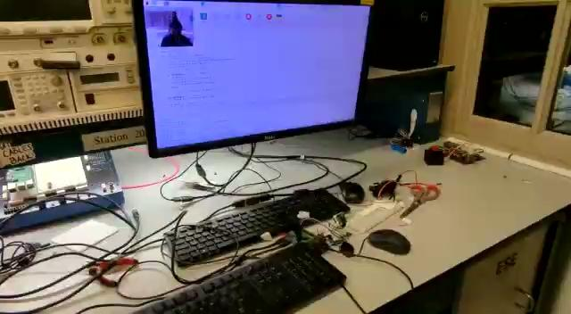
Result - Face Tracking & Human Detection
Pan-Tilt camera:
LCD:

Slide 14
Future Scope
In the Dino Game section, visitors will be able to select the game they wish to play. So, instead of just one option for playing the Dino Game, we'll provide you a range of games to play.
Face tracking pan tilt will send a notification to the parent of the child who will be playing if it does not identify the child for more than 5 minutes. It would serve as a surveillance device, tracking children while they played.
For human interaction, we can upgrade it to operate like "Google Assistant," which can display real-time statistics such as temperature and pressure and chat with the user as a virtual assistant.

Slide 15
Thank You !!!

